Slide 1
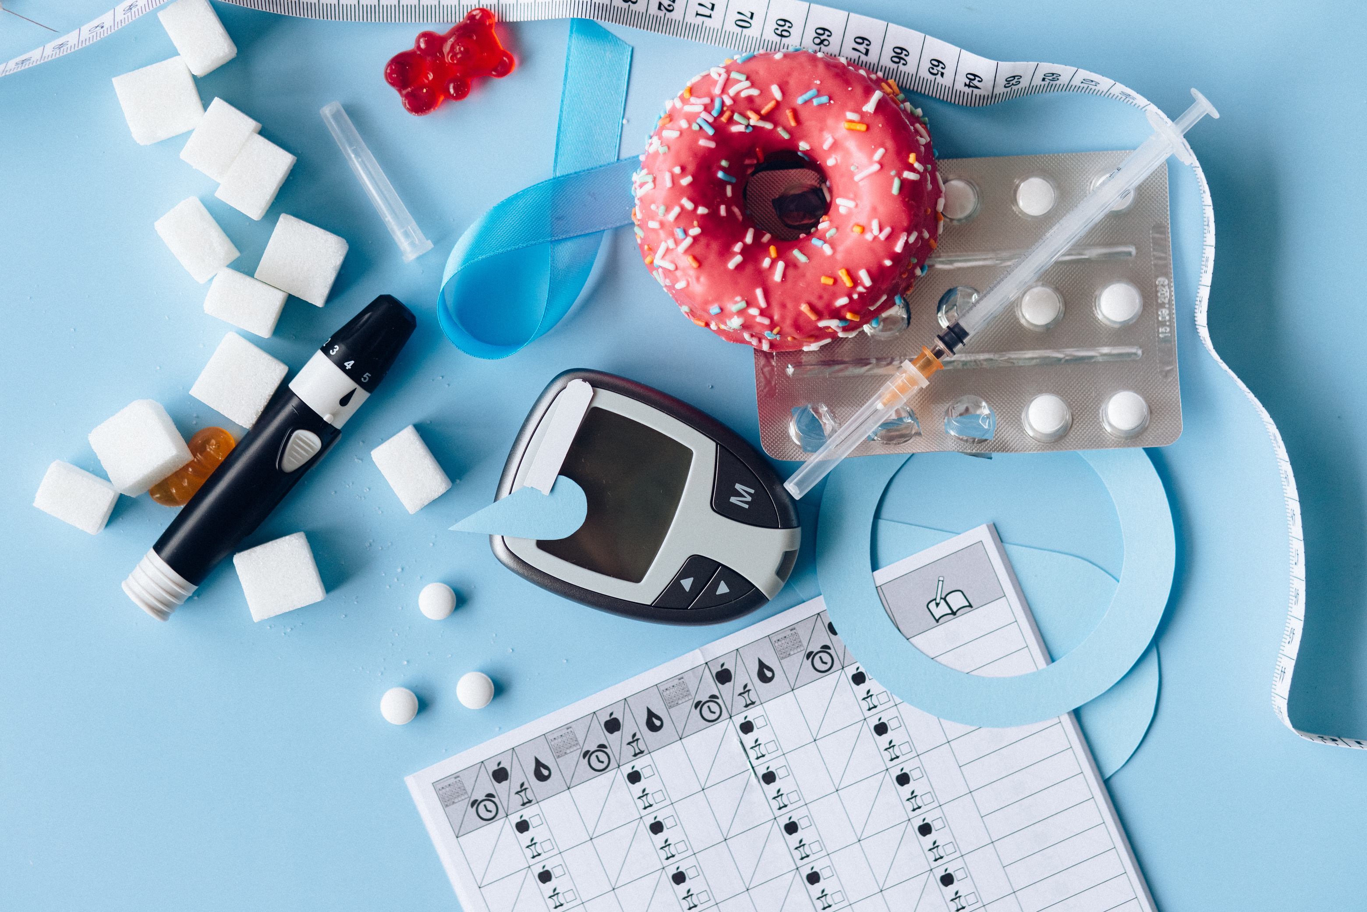
Predicting diabetes using general health indicators
Name : Alaa ashrf lotfy
ID:221001804

Slide 2
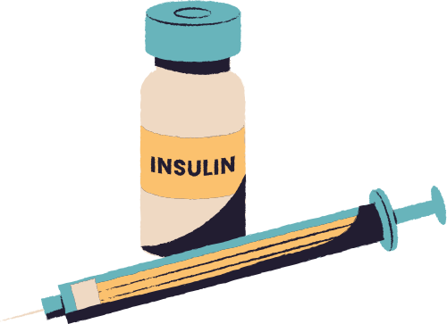
Introduction
The data was collected from the BRFSS 2015 health survey.
It includes over 250,000 records and 21 health-related indicators.
Objective: To build a machine learning model that predicts whether an individual has diabetes using health indicators.

Slide 3
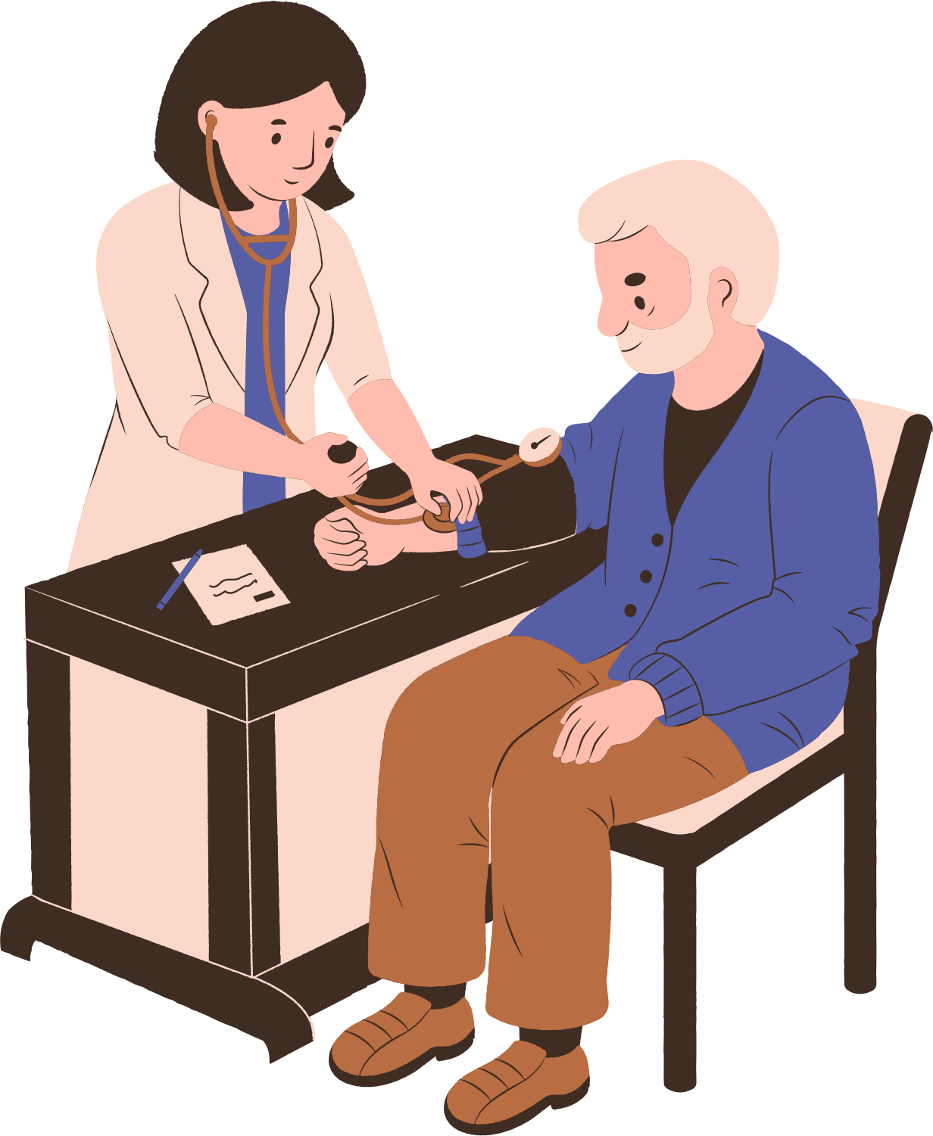
Project Workflow
Data import and initial processing
Data cleaning and outlier removal
Exploratory Data Analysis (EDA)
Data balancing using SMOTE
Feature selection and scaling
Model building and evaluation
Saving the best model
Deployment using Streamlit

Slide 4
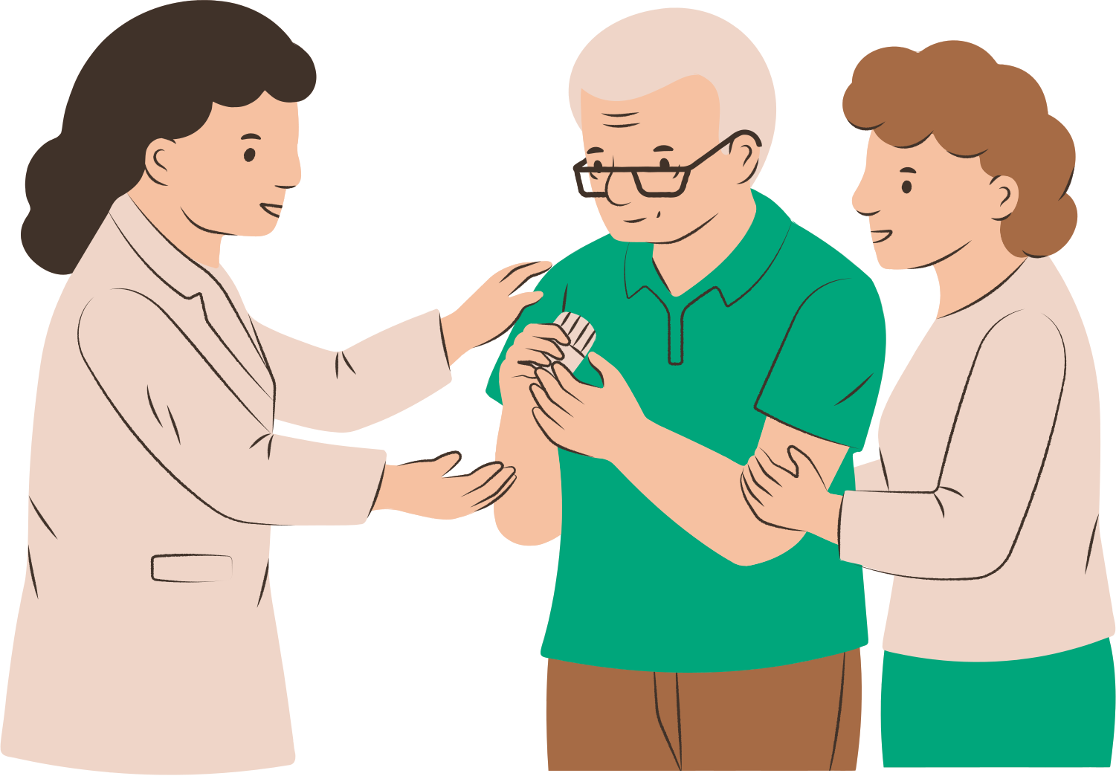
Data Preprocessing Steps
Removed outliers using Z-Score method
Applied SMOTE to balance class distribution
Split data into Training and Testing sets
Standardized numerical features using StandardScaler

Slide 5
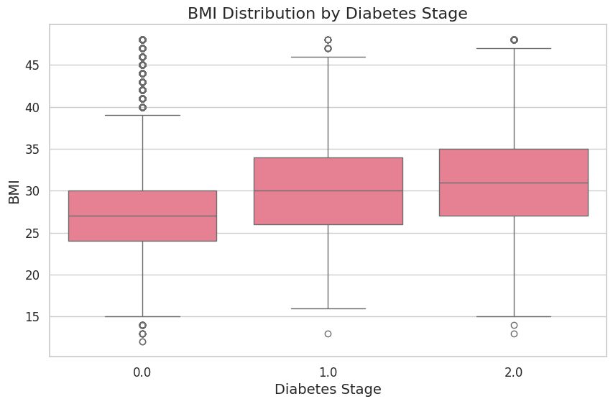
Exploratory Data Analysis (EDA)
I used tools such as Bar Plots, Heatmaps, Histograms, Box Plots, and Pair Plots. I studied the relationship between diabetes and:
Body Mass Index
High Blood Pressure
Smoking
Physical Activity
General Health
BMI Distribution: A box plot showing the distribution of Body Mass Index (BMI) for each diabetes stage.

Slide 6
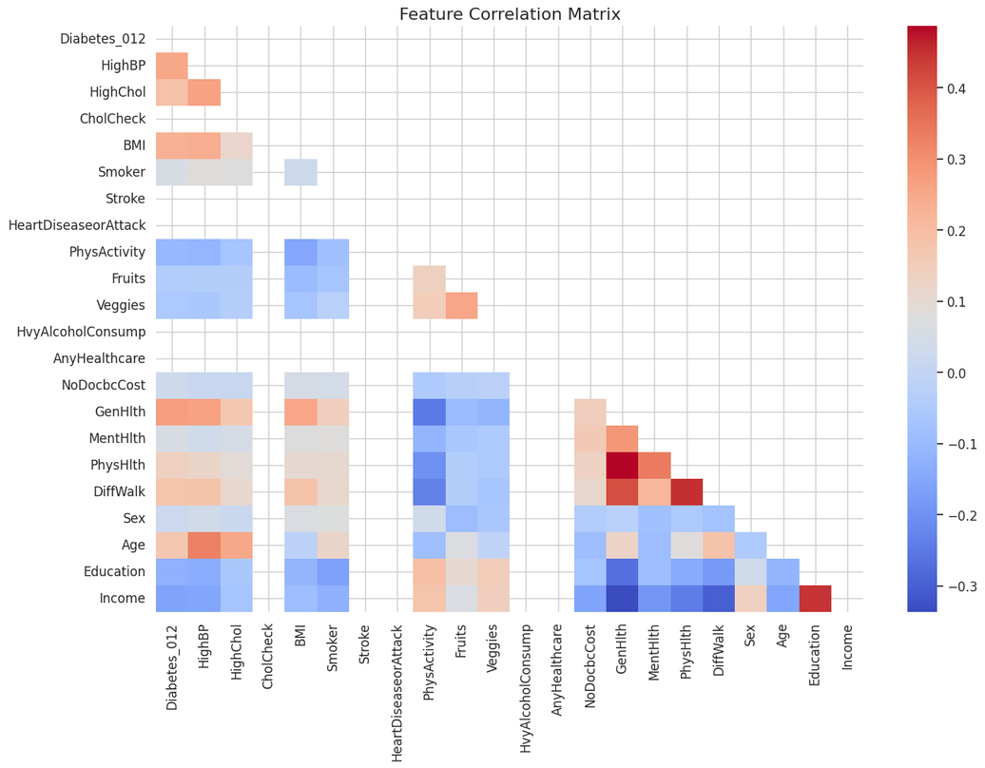
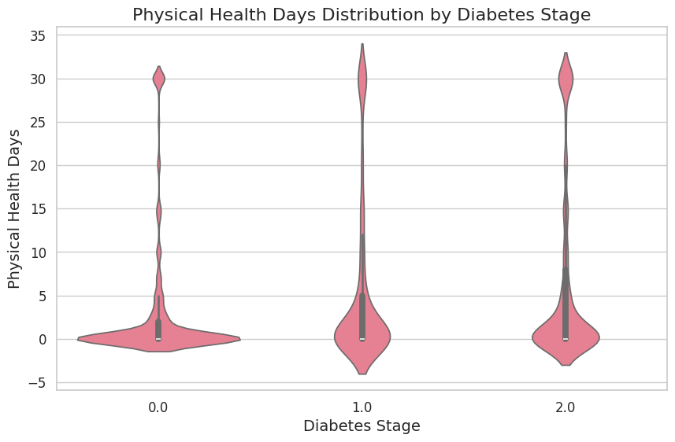
Exploratory Data Analysis (EDA)
Feature Correlation Matrix: This heatmap displays the Pearson correlation between various health-related features in a dataset.
Physical Health Days Distribution: A violin plot illustrating the distribution of reported poor physical health days across three stages of diabetes (non-diabetic, prediabetic, and diabetic).

Slide 7
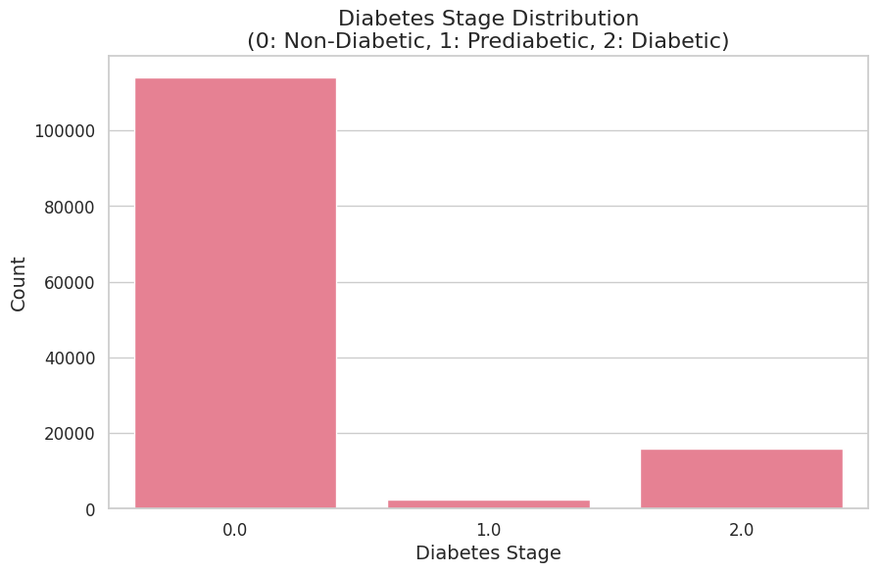
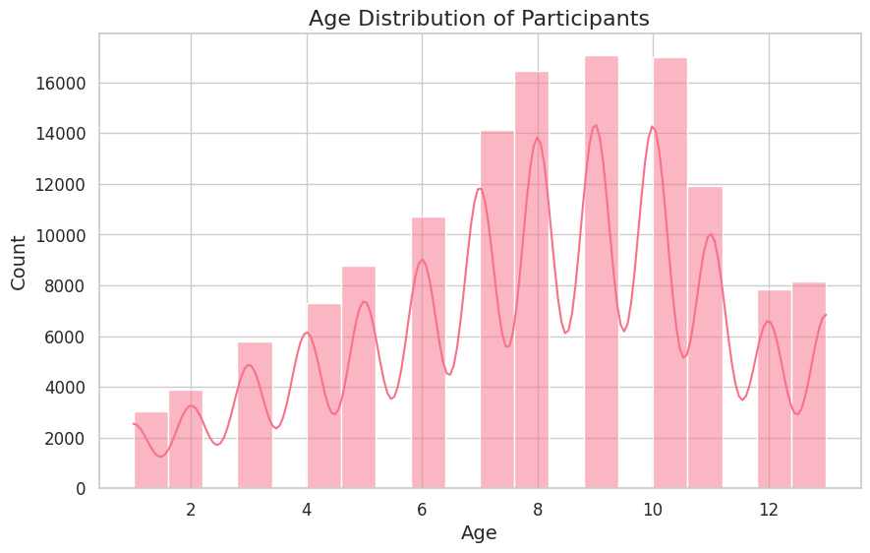
Exploratory Data Analysis (EDA)
Diabetes Stage Distribution: A bar chart illustrating the count of participants in each category: non-diabetic (0), prediabetic (1), and diabetic (2).
Age Distribution: A histogram showing the frequency distribution of participants' ages.

Slide 8
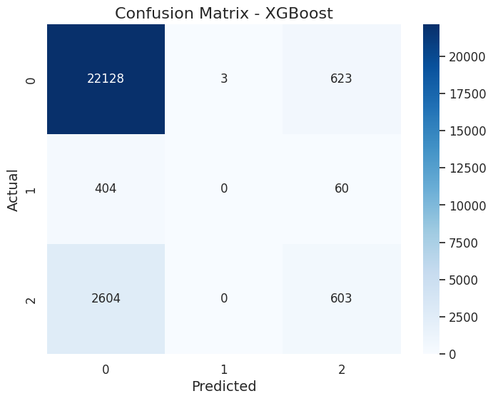
Best Model & Saving
The best model was XGBoost.
It was saved using joblib.
And it was used in the final application.

Slide 9
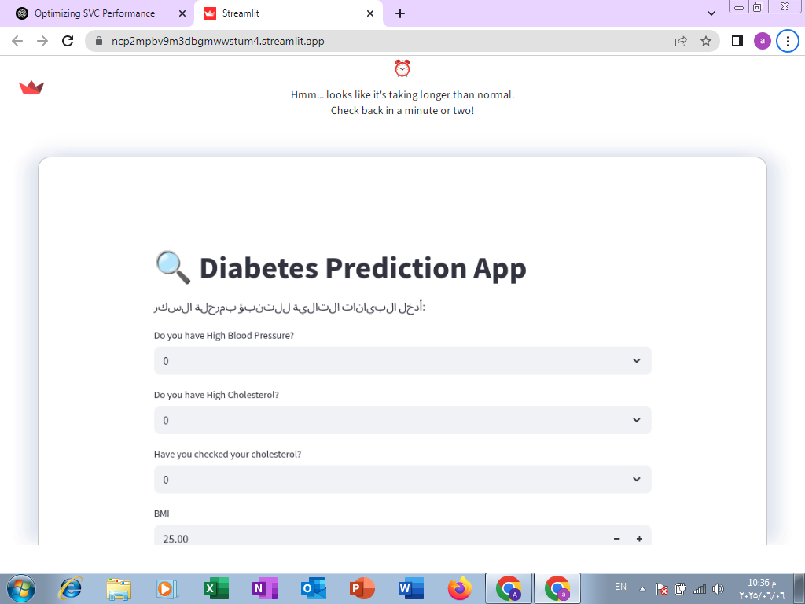
Deployment
I used Streamlit to create an interactive interface.
https://ncp2mpbv9m3dbgmwwstum4.streamlit.app/

Slide 10
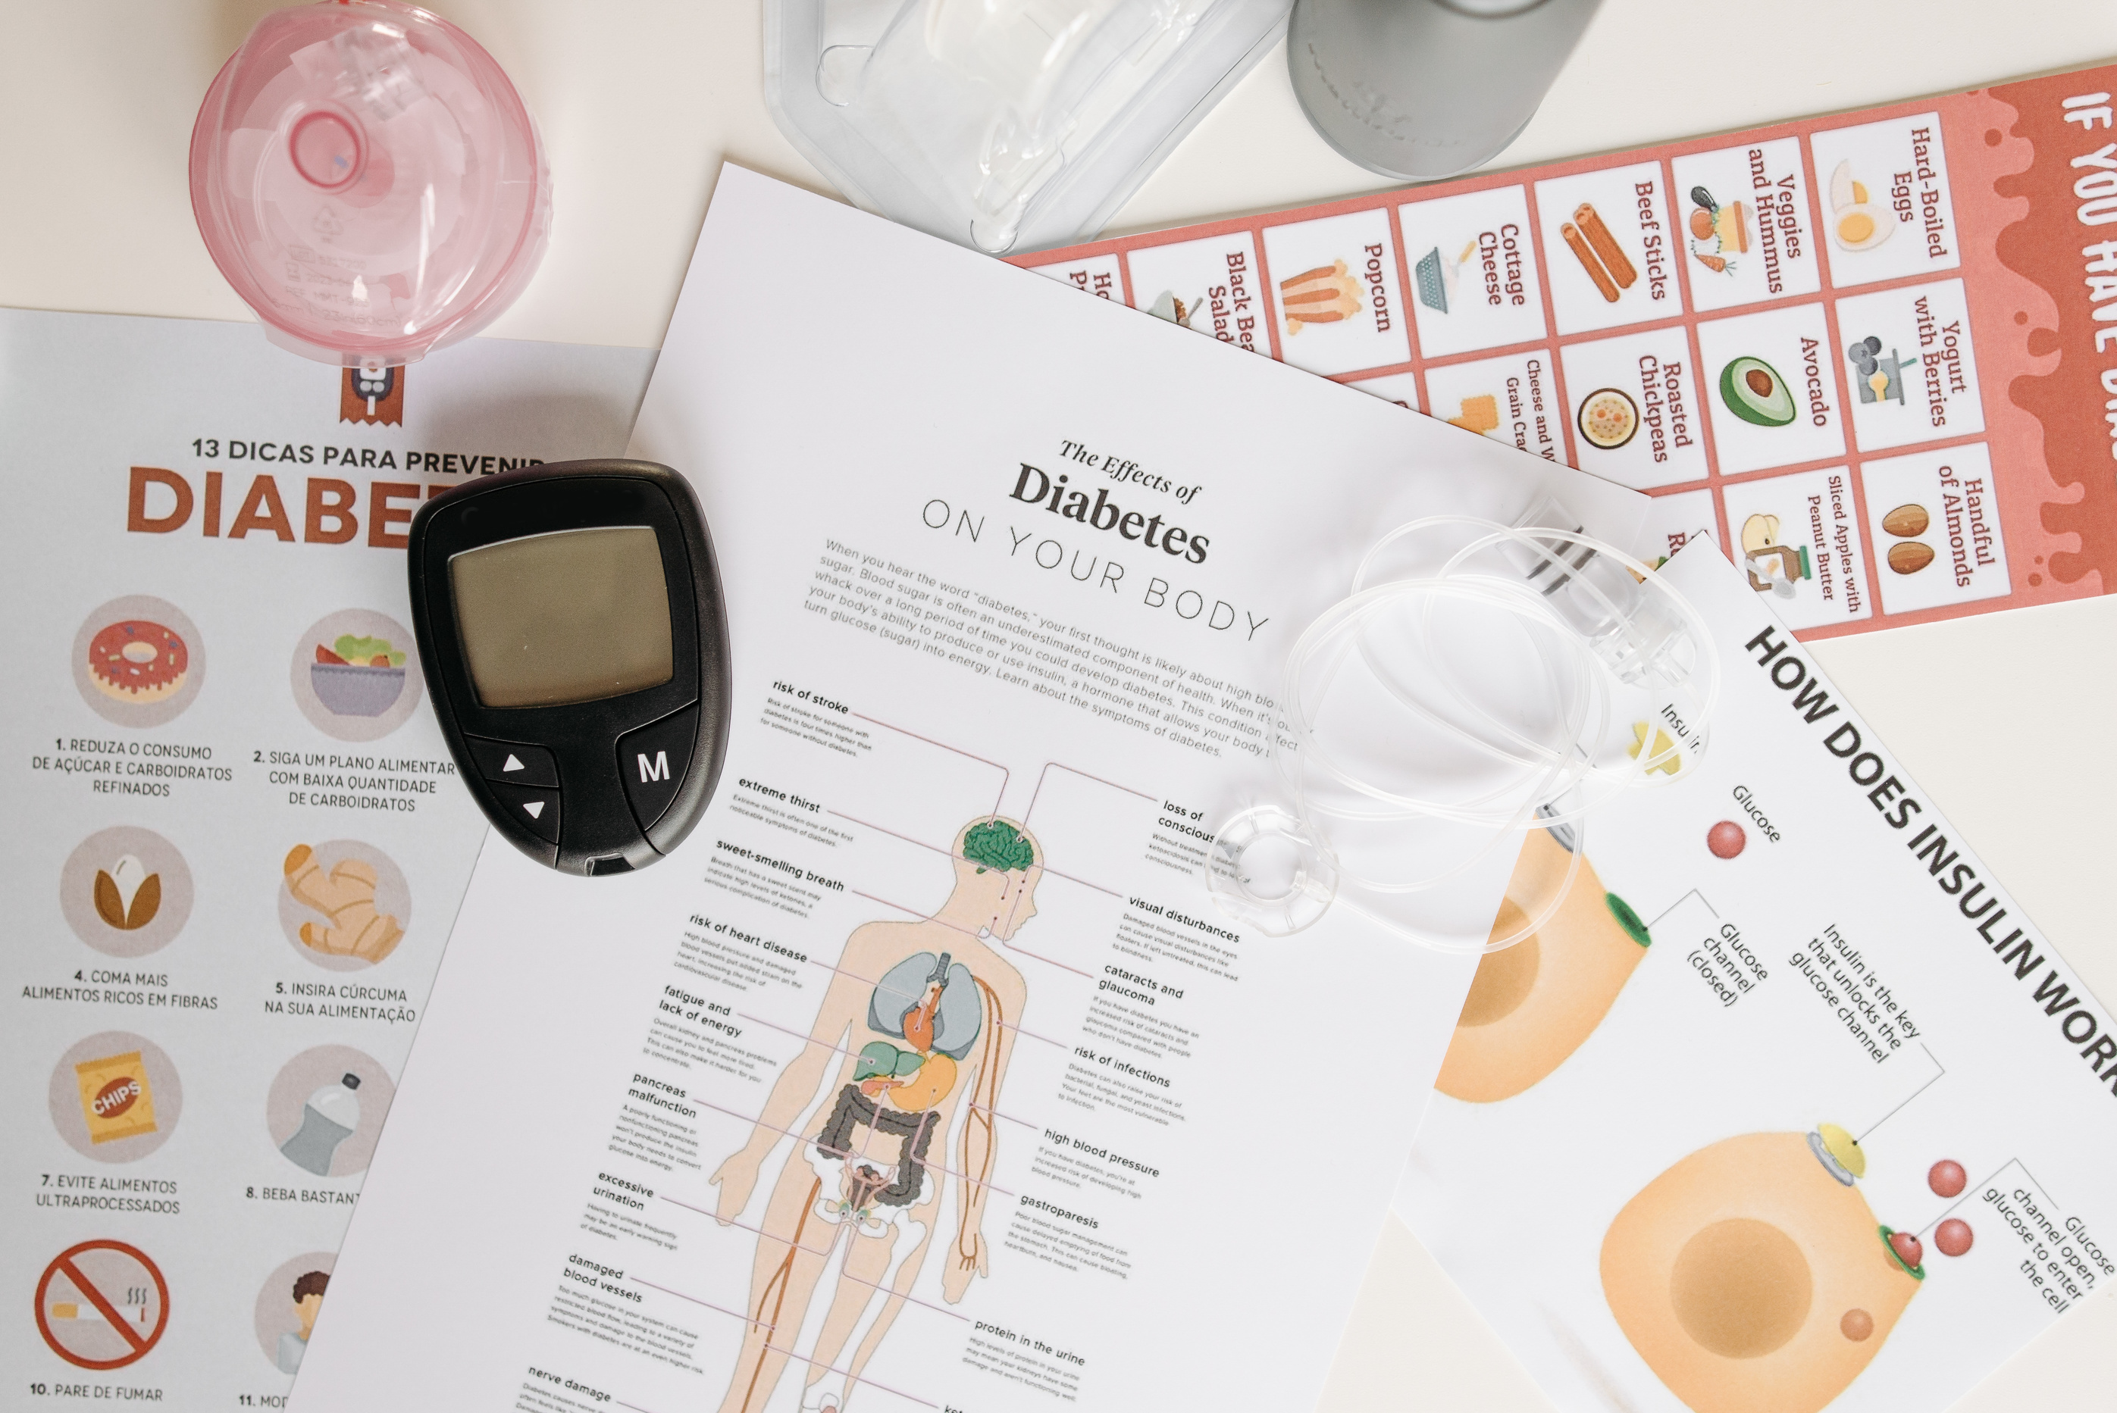
THANK YOU

